Slide 1
Programming Language II C#
Lecture – 7 Exception Handling

Slide 2
What is exception
Dictionary Meaning: Exception is an abnormal condition.
In C#, exception is an event that disrupts the normal flow of the program. It is an object which is thrown at runtime.

Slide 3
The C# language's exception handling features help you deal with any unexpected or exceptional situations that occur when a program is running.

Slide 4
What is exception handling
Exception Handling is a mechanism to handle runtime errors.
Run Time errors are those that are detected when the program execute.
For example, division by zero. The compiler can not know if the operation (x/y) will leads to division by zero until the execution.

Slide 5
Advantage of Exception Handling
to maintain the normal flow of the application.
Exception normally disrupts the normal flow of the application that is why we use exception handling

Slide 6
Why Exception Handling
statement 1;
statement 2;
statement 3;
statement 4;
statement 5;//exception occurs
statement 6;
statement 7;
statement 8;
statement 9;
statement 10;
Suppose there is 10 statements in your program and there occurs an exception at statement 5, rest of the code will not be executed i.e. statement 6 to 10 will not run. If we perform exception handling, rest of the statement will be executed. That is why we use exception handling in java.
int a = 10;
int b = 0;
a + b;
a + b;
a + b;
a / b;//exception occurs
a + b;
a + b;
a + b;
a + b;
a + b;

Slide 7
try: A try block identifies a block of code for which particular exceptions is activated. It is followed by one or more catch blocks.
catch: A program catches an exception with an exception handler at the place in a program where you want to handle the problem. The catch keyword indicates the catching of an exception.
finally: The finally block is used to execute a given set of statements, whether an exception is thrown or not thrown. For example, if you open a file, it must be closed whether an exception is raised or not.
throw: A program throws an exception when a problem shows up. This is done using a throw keyword.

Slide 8
Exception Handling Syntax
try
{
// statements causing exception
}
catch( ExceptionName e1 )
{
// error handling code
}
catch( ExceptionName e2 )
{
// error handling code
}
catch( ExceptionName eN )
{
// error handling code
}
finally
{
// statements to be executed
}

Slide 9
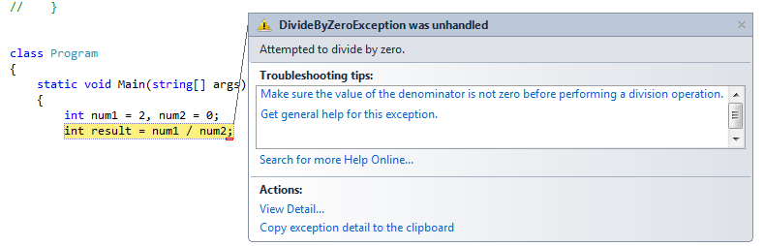
1. Divide by Zero Exception

Slide 10
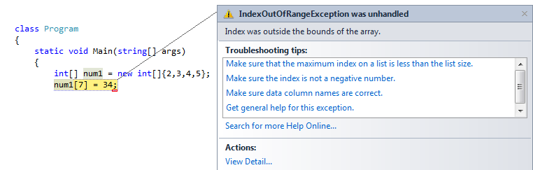
2. IndexOutOfRange Exception

Slide 11
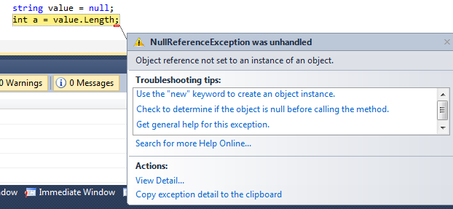
3.NullRefernce Exception
string value = null;
int a = value.Length;

Slide 12
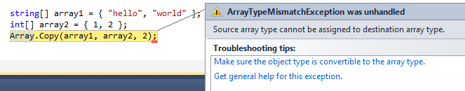
4.Array Type Mismatch Exception

Slide 13
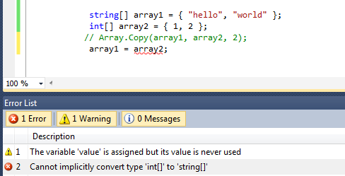
Runtime ERROR?

Slide 14
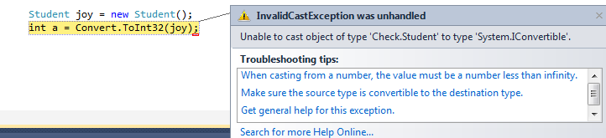
5.Invalid cast Exception

Slide 15
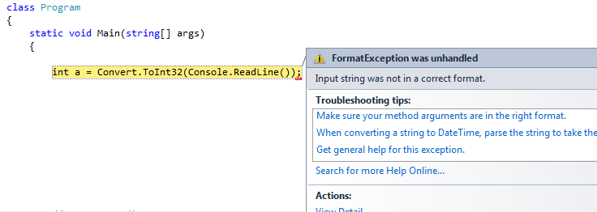
6. FormatException

Slide 16

7. Overflow Exception

Slide 17
Handling exception
using System;
class Program
{
static void Main()
{
try
{
int result = 15 / int.Parse("0");
Console.WriteLine(result);
}
catch (DivideByZeroException e)
{
Console.Write(e.Message);
Console.ReadLine();
}
}
}

Slide 18
using System;
class Program
{
static void Main()
{
try
{
string value = null;
if (value.Length == 0)
{
Console.WriteLine(value);
}
}
catch(NullReferenceException e)
{
Console.WriteLine(e.Message);
}
Console.Read();
}
}

Slide 19
